Slide 1
Johnson County
Budget Reforecast and Market Updates
2/10/2026

Slide 2
Agenda
Market & Regulatory Insights
Plan Performance
Health Plan Key Indicators
Next Steps

Slide 3
2025 Market Insight Summary
Growing Healthcare Cost: Highest Rate in a Decade
Pharmacy
Growing Share of Budget
GLP1 Meds Top Driver
Vendor Partners
Prove Cost Impact
Integrate & Simplify
1
3
High-Cost Claimants
Cancer
Cardiovascular
Chronic Kidney Disease
Policy & People
ERISA Preemption
Mental Health
Health Equity
2
4
Business Group on Health. 2025 Employer Health Care Strategy Survey. August 2024. Available at: https://www.businessgrouphealth.org/resources/2025-Employer-Health-Care-Strategy-Survey-Intro.

Slide 4
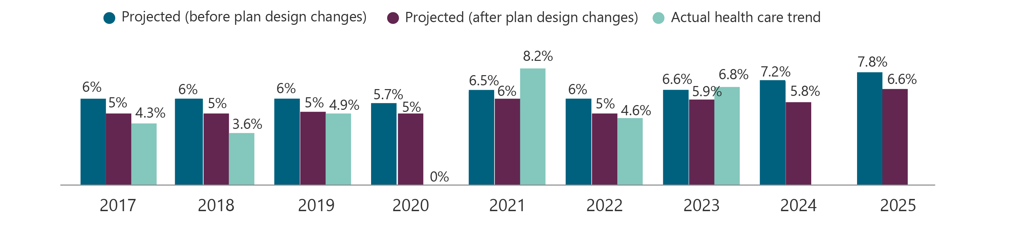
Growing Healthcare Costs
Projected increase in health care trend, before plan design changes, rose from 6% in 2022
to almost 8% for 2025. More than 50% increase in health care cost since 2017. Employers are preparing to absorb much of the increase as they have done in recent years.
Johnson County’s health care trend rose from .3% in 2024 to 11.8% in 2025
Johnson County’s (employer spend) 2024 PEPY $14,272 2025 PEPY $19,487
Business Group on Health. 2025 Employer Health Care Strategy Survey. August 2024. Available at:
https://www.businessgrouphealth.org/resources/2025-Employer-Health-Care-Strategy-Survey-Intro.
Notes:
Since 2022, the projected increase in health care trend, before plan design changes, rose from 6% in 2022 to almost 8% for 2025.
Even after plan design changes, actual health care costs continued to grow at a rate exceeding pre-pandemic increases.
These increases point toward a more than 50% increase in health care cost since 2017.
Moreover, this health care inflation is expected to persist and, in light of the already high burden of medical costs on the plan and employees, employers are preparing to absorb much of the increase as they have done in recent years.

Slide 5
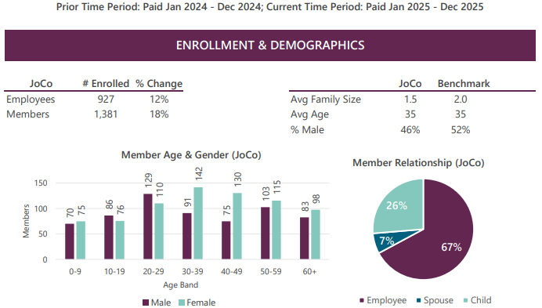
Demographics

Slide 6
Spend Detail by Plan
Medial Plan | Average Contract Size | Medical PEPM | Pharmacy PEPM
PPO | 1.79 | $1,640 | $674
HMO | 1.42 | $817 | $408
HDHP | 1.45 | $1,004 | $336
Average Contract Size = The ratio of total covered members (employees, spouses, and dependents) to the number of employees (subscribers) enrolled in a health plan.
Higher contract size = More dependents per employee

Slide 7
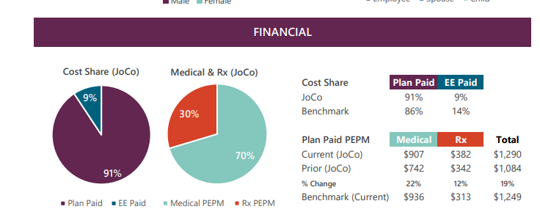
Financials - 2025

Slide 8
Medical Performance Summary
2026 National Trend: 9.3% Medical
Rolling 12 Medical Trend JC through December: 2.3%
Rolling 12 Medical Trend JC through February: 1.7%
Notes:
[This is a placeholder for any Monthly Performance Summary files.]
For self-funded
For fully-insured, if HMA reporting is not available, include info from Program History spreadsheet

Slide 9
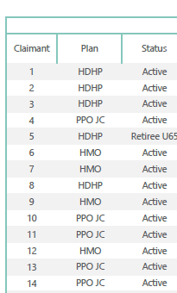
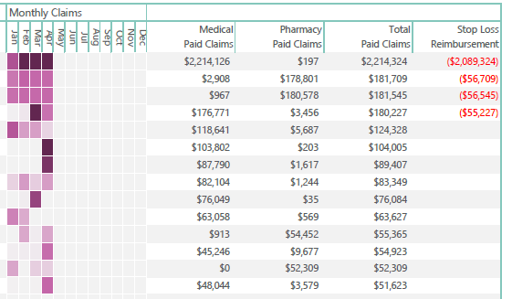

High-Cost Claimants Through April, 2026

Slide 10
Pharmacy Performance Summary
2026 National Trend: 11.0% Pharmacy
Rolling 12 Pharmacy Trend JC through December: 30.6%
Rolling 12 Pharmacy Trend JC through February: 27.9%
Notes:
[This is a placeholder for any Monthly Performance Summary files.]
For self-funded
For fully-insured, if HMA reporting is not available, include info from Program History spreadsheet

Slide 11
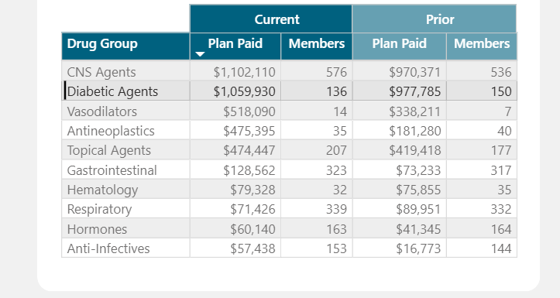
Top Drug Groups
Notes:
CNS agents - brain, anti dep, adhd, pain

Slide 12
2026 Updated Budget Forecast

Slide 13
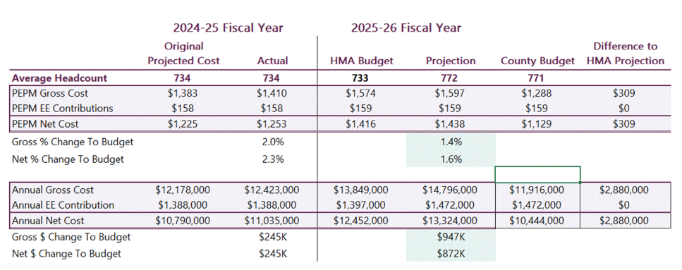
Performance Summary
*Holmes Murphy confirmed that the variance between the HMA projection and the County budget will be funded through the current $10.7 million fund balance.

Slide 14
Next Steps
Commissioner’s Court Review – May
          Plan Performance
          Marketing Discussion – Benefit Administration Platform
                Budget Update – June 2026, including March/April data
          Finalize budget for 2026-2027 plan year
                Compliance Meeting - July

Slide 15
Thank you

Slide 16
Performance Summary
2026 National Trend: 11.0% Pharmacy
Rolling 12 Pharmacy Trend for Johnson County: 30.6%
Notes:
[This is a placeholder for any Monthly Performance Summary files.]
For self-funded
For fully-insured, if HMA reporting is not available, include info from Program History spreadsheet

